Slide 1
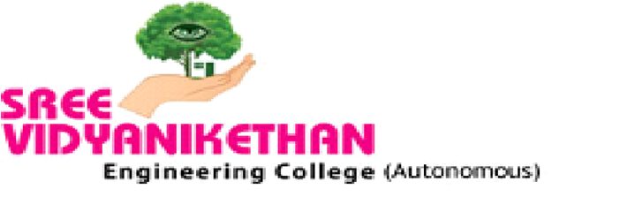
Playing Rock-Paper-Scissors with AI
Presented By
s
Name: KAPU TIRUMALA SAI TEJA
Roll No: 18121A05A3
Computer Science and Engineering
(AUTONOMOUS)
(Approved by AICTE, Accredited by NBA and Affiliated to JNTUA, Anantapur)
2021-2022
Under the guidance of
Dr. B. Narendra Kumar Rao,
Professor & Head,
Dept. of CSE

Slide 2
Index
Abstract
Introduction
Literature Survey
Statement of Problem
Objectives
Hardware and Software Requirements
Existing System
Proposed System
Approach and Algorithm
UML Diagrams
Results
Conclusion and Future Work
References

Slide 3
ABSTRACT:
In this modern era, day to day life became smarter and interlinked with technology. We can chat with AI chat bots, we can play with AI machines. In many of the cases AI machines are defeating human players. All age group people are like to play these games. The computer gaming industry has found Artificial Intelligence as a necessary element to make more entertaining and challenging. This is an implementation of a Rock-Paper-Scissors (RPS) game interaction with an AI machine. The framework is tailored to be computationally lightweight, as well as entertaining and visually appealing. The fundamental gesture recognition pipeline employs a Leap motion device and two separate machine learning architectures to evaluate kinematic hand data on-the-fly in Python. This proposed system will offer a powerful application for the subsequent exploration of social human-machine interaction.

Slide 4
INTRODUCTION:
Today the development of artificial intelligence (AI) systems that can organize a natural human-machine interaction (through voice, communication, gestures, facial expressions, etc.) are gaining in popularity.
One of the most studied and popular was the direction of interaction, based on the understanding of the machine by the machine of the natural human language.
The classic Rock-Paper-Scissors (RPS) game constitutes a simple action and effect interaction with long-standing fascination for various research domains.
For psychology, analysis of the basic gestural play can be interesting to identify patterns or strategies in human decision-making process .
In engineering and robotics, RPS game interactions between a human and a robot player build the base for two main research questions: basic technological development on the one hand, and its deployment in Human-Machine-Interaction studies on the other.

Slide 5
Literature Survey
Authors and Year | Title | Proposed | Outcomes
Heike Brock 1, Javier Ponce Chulani2, Luis Merino 2, Deborah Szapiro3, And Randy Gomez 1(2020) | “Developing a Scalable Rock-Paper-Scissors Framework for Human-Robot Collaborative Gaming”. | The implementation of the Rock-Paper-Scissors game interaction with a computer is presented. With the teamwork of both designers and animators, this game is designed to the final stage. | The system will analyze the user play pattern in the real world. It’s a great window to a new way of interaction between a human and a machine.
H. Brock, S. Sabanovic, K. Nakamura, and R. Gomez(2020), | "Robust real-time hand gestural recognition for nonverbal communication with tabletop robot Haru," | The hand gesture recognition system is created by Leap motion to train the machine learning architecture for user hand gesture recognition. | The system is evaluated using data from simulations of real-world human-robot interactions, investigate the behaviour of the system with help of the performance variables like the pattern of movement, timing, and posture.

Slide 6
Literature Survey
Authors and Year | Title | Proposed | Outcomes
Farag and H. Brock (2019), | " Learning motion disfluencies for automatic sign language segmentation," | a novel technique for automatically detecting words within sentence expressions in Sign Language of japan from 3-dimensional body joint positions, was introduced. | The classifier's output is used to propose an automatic word generation method that achieves reliable and very accurate sentence formation with a good average frame-wise F1 score of 0.89.
C. Lugaresi, J. Tang, H. Nash, C. McClanahan, E. Uboweja, M. Hays,F. Zhang, C.-L. Chang, M. Guang Yong, J. Lee, W.-T. Chang, W. Hua, M. Georg, and M. Grundmann (2019), | ‘’A framework for making pipelines for perception’’ | They created applications to perceive the world around them even though it’s difficult | Algorithm or model making while using Media-Pipe as an environment for exponentially developing their application with results that are reliable and reproducible on multiple platforms and devices.

Slide 7
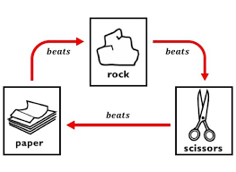
Statement of Problem
Developing a game interface between a human and a system using OpenCV techniques and the Python programming language to recognize the person's hand gesture and play against the person by picking one of three hand gestures.

Slide 8
Objectives
To build a framework for reading human inputs.
To detect the presence of human hands in the frame.
To classify whether the hand gesture is a paper, rock, or scissors based on human input.
To select the victor by using winning criteria.
To determine the final winner, who reaches a score of 3 at the outset.

Slide 9
Hardware and Software Requirements:
Software Requirements:
Languages : Python 3.6 or high version.
Packages : Mediapipe, Numpy, OpenCV, Pygame, Time.
Hardware Requirements:
Operating Systems : Windows 10
Processors : Any Intel or AMD x86-64
RAM : 4 GB
Hard disc or SSD : More than 500 GB
Camera : Internal or external

Slide 10
Existing System
Python is a multifunctional language that may be used for almost anything. Python can also be used to create video games.
In this game, the user has the first opportunity to choose between Rock, Paper, and Scissors. After that, the computer selects one of the remaining two options (at random), and the winner is determined according to the rules.
In this game, the inbuilt function randint() is used to generate random integer values within the given range.
The main aspect here is how we provide the computer input or make a choice.

Slide 11
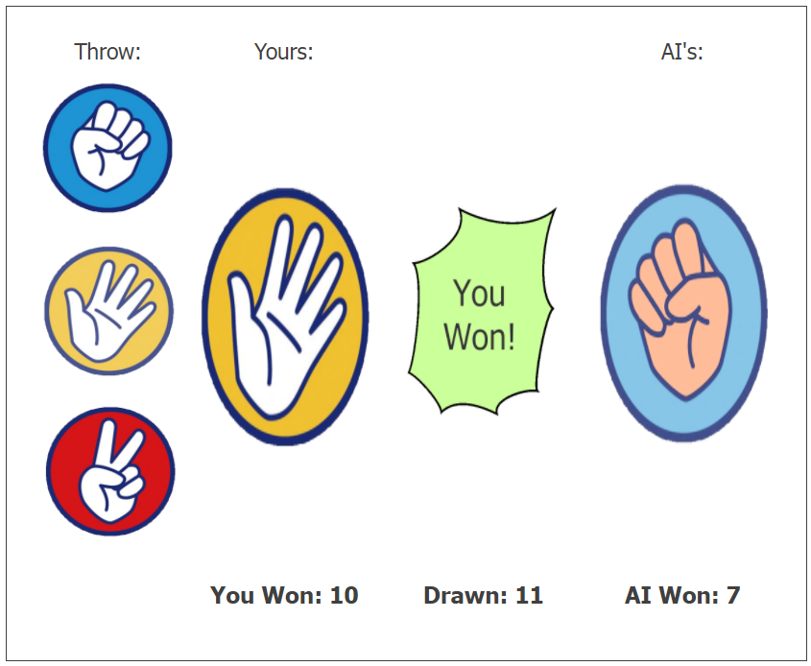
Existing System
It may be selecting one of the three pictures displayed by clicking on it, or entering the spelling or number of our choice.
However, gamers will find this monotonous because it is merely a simple technique of providing input
and there will be very little interaction between both the player and the computer.
Here, players can select from the three images displayed (rock, paper or scissors) by clicking on it.

Slide 12
Proposed System
Rock, Paper and Scissors (RPS) becomes lot more intriguing thanks to computer vision.
It will be a two-way conversation between a computer and a human. Winning Rock, Paper and Scissors (RPS) is based on random moves, so it is not a model of a winning AI system as no strategy is used.
The system's only intelligence would be in visual recognition of hand signs.
OpenCV (Open Source Computer Vision Library) is a library of programming functions mainly aimed at real-time computer vision.
The OpenCV runs on Windows, Linux, macOS, FreeBSD, NetBSD, OpenBSD.
MediaPipe Hands is a high-fidelity hand and finger tracking solution. It employs machine learning (ML) to infer 21 3D landmarks of a hand from just a single frame.

Slide 13
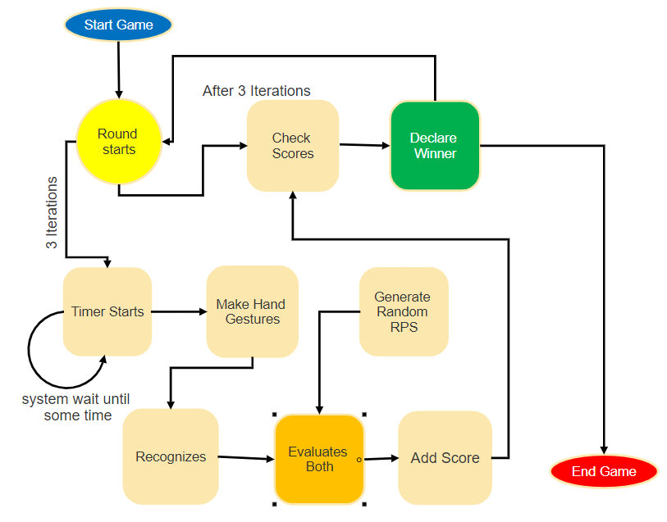
System Architecture

Slide 14

Approach
Build a hand gesture recognizer
Working with key Points
Defining Gestures

Slide 15
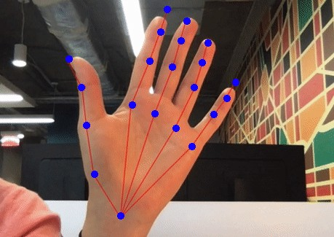
Build a Hand Gesture Recognizer
When building a Rock, Paper, Scissors game, the key challenge is to recognize the three hand gestures ✊ ✌ inside a camera picture.
The first step is to detect whether a hand is actually inside the camera picture.
If a hand is detected, we estimate the position of all finger joints to trace the hand skeleton.

Slide 16
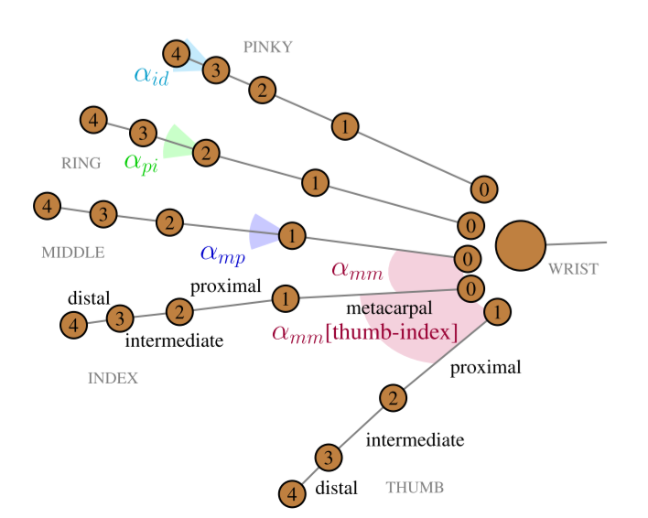
Working with key Points
The hand skeleton detector returns 21 key points (also called “landmarks”): Four joints for each finger plus the wrist.
The key points represent 2D coordinates, telling us the position of each skeleton point in the picture.
This isn’t very useful to describe a hand gesture, as it is hard to compare two hand gestures based on the position of the joints.
A hand can appear anywhere in the picture, it could be rotated, and people could be left- or right-handed.

Slide 17
So, Describing a hand gesture using natural language is a better approach.
Take the “Thumbs Up” gesture 👍 as an example: It can be described as “All four fingers fully curled and pointing to either the left or right. Thumb must not be curled and point upwards”.
Curl and pointing direction are a much more concise way of describing a hand gesture. They are independent of the size and position of the hand in the camera picture, also both can easily be deduced from the raw 2D coordinates.
This brings us to the next steps in detection process:
Describe the curl and pointing direction for each detected finger using the key points.
Finally, compare this description to a list of known hand gestures and check which one is the best match.

Slide 18
Defining Gestures
The rock gesture is basically just you making a fist:
You bend your fingers into your palm, curling them under until the tip of each finger touches its corresponding base.
Then you bend the thumb down so that it falls across the top halves of the index and middle fingers.
This code describes a “rock” gesture as:
All fingers fully curled
Paper Gesture
To make a “paper” gesture, you have to stretch out all of your fingers and your thumb.
Scissors Gesture
The “scissors” gesture closely resembles a “victory” sign. Index and middle fingers are stretched out. Ring and pinky should be half or fully curled.

Slide 19
Algorithm
FEATURE TRACKING AND PROCESSING :
Features should be simple and robust towards sensing and tracking errors present in the provided hand information.
Engineer the features to be extracted easily and fast in order to reduce computational overload and avoid delay in the overall signal processing.
Moreover, to avoid dependence on the internal feature computation processes, all features base on the hand joint positions only.
As such, proposed game pipeline could also be implemented similarly without a Leap device in the future, e.g. by utilizing video-based systems with hand tracking options such as OpenPose or MediaPipe.

Slide 20
Algorithm
FEATURE TRACKING AND PROCESSING :
MOVEMENT SEGMENTATION FEATURES
SHAPE RECOGNITION FEATURES

Slide 21

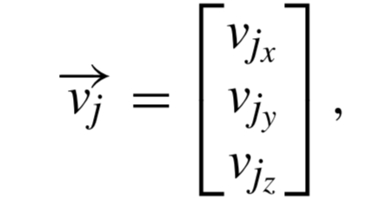

Algorithm
FEATURE TRACKING AND PROCESSING :
MOVEMENT SEGMENTATION FEATURES
Form the set of feature representations FSeg utilizing the basic velocity and direction vectors of a player’s hand. These are representing the velocity in 3D space of any joint j ∈ J as
whereas J constitutes the set of palm and finger tip joints, and representing relative changes of the vectors d ∈ D as

Slide 22
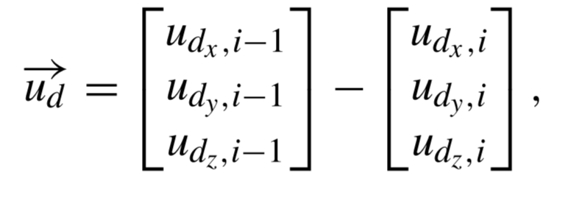

Algorithm
FEATURE TRACKING AND PROCESSING :
MOVEMENT SEGMENTATION FEATURES
whereas D constitutes the set of normal and direction vectors of the palm and i ∈ [2, . . . , n] with n denoting the length of a motion sequence. The final feature set is then defined as
for all j and d respectively.

Slide 23
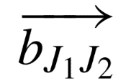
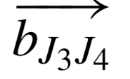
Algorithm
FEATURE TRACKING AND PROCESSING :
2) SHAPE RECOGNITION FEATURES
Utilizing the positions of finger joints in 3-dimensional space, the classes ’Rock’, ’Paper’ and ’Scissors’ can be uniquely described by their angular and distal relations.
The set of feature representations FShape therefore constitutes the normalized inter-joint angles computed from a hand’s raw joint positions.
For all neighboring finger bones, compute the angle α of the length-normalized inner product of the two vectors and representing the respective bones (J1, J2) and (J3, J4) as

Slide 24
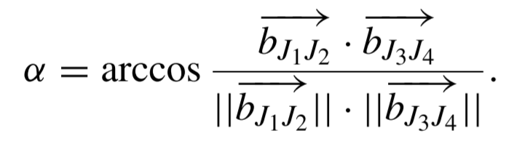
Algorithm
FEATURE TRACKING AND PROCESSING :
2) SHAPE RECOGNITION FEATURES
This provides us with the angles αmm between metacarpal finger bones (respectively between proximal and metacarpal bone for the thumb and index finger), as well as the angles ‘αmp’ between metacarpal and proximal bone, ‘αpi’ between proximal and intermediate bone and ‘αid’ between intermediate and distal bone of every finger.

Slide 25
Algorithm
Combine the angles to the final feature set FShape1 = {αmm, αmp, αpi, αid}.
For subsequent comparison,
furthermore build a second set FShape2 = {αpp[thumb-index], αmp, αpi} with reduced morphological information.

Slide 26
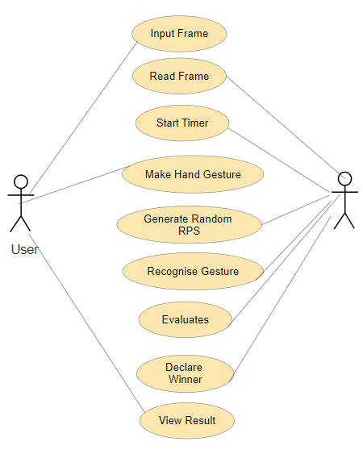
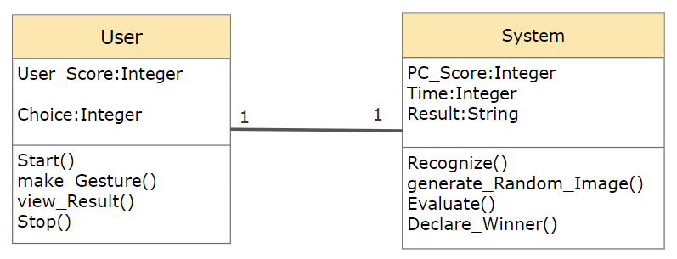
UML Diagrams
Use Case Diagram
Class Diagram

Slide 27
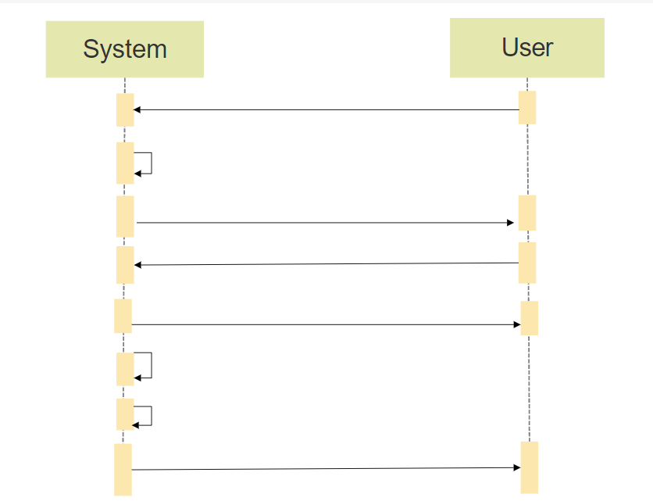
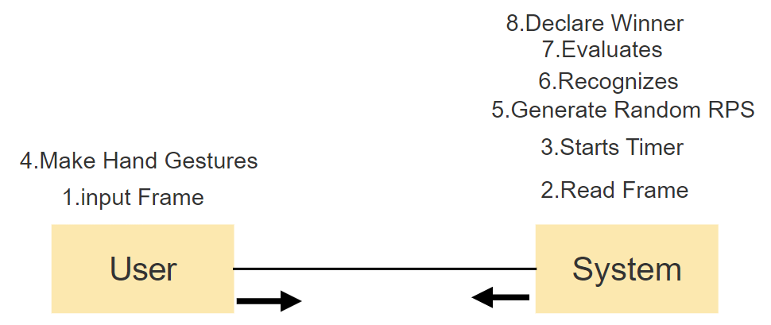
Sequence Diagram
UML Diagrams
Input Frame
Read Frame
Starts Timer
Make Hand Gesture
Generate random RPS
Recognizes
Evaluates
Declare Winner
Collaboration Diagram

Slide 28
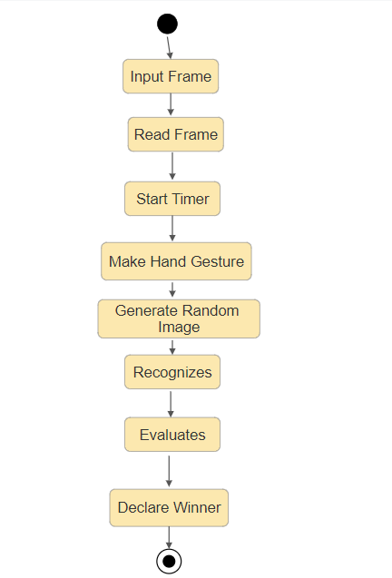
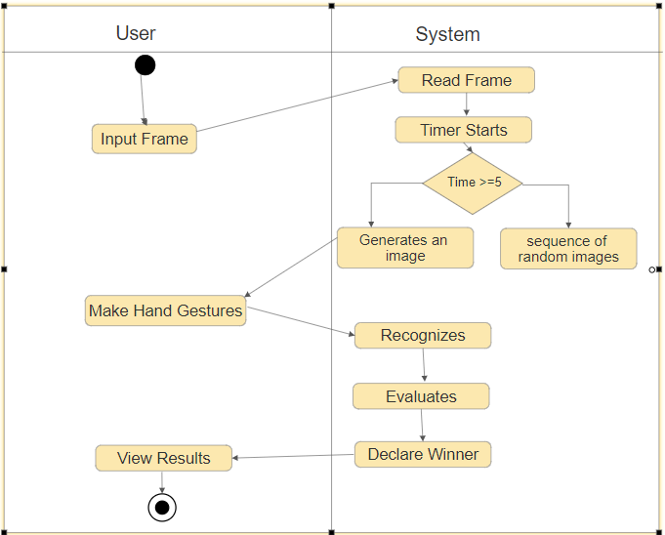
UML Diagrams
State Diagram
Activity Diagram

Slide 29
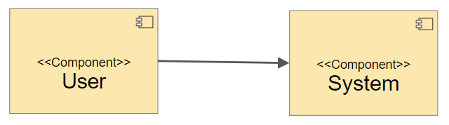
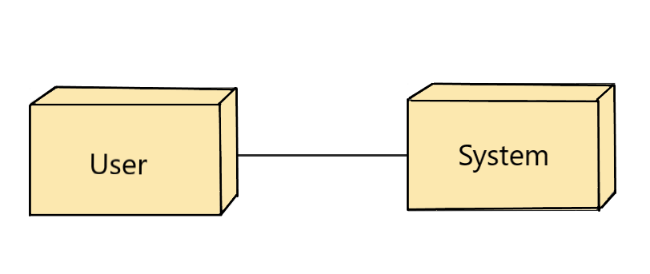
Deployment Diagram
UML Diagrams
Component Diagram

Slide 30
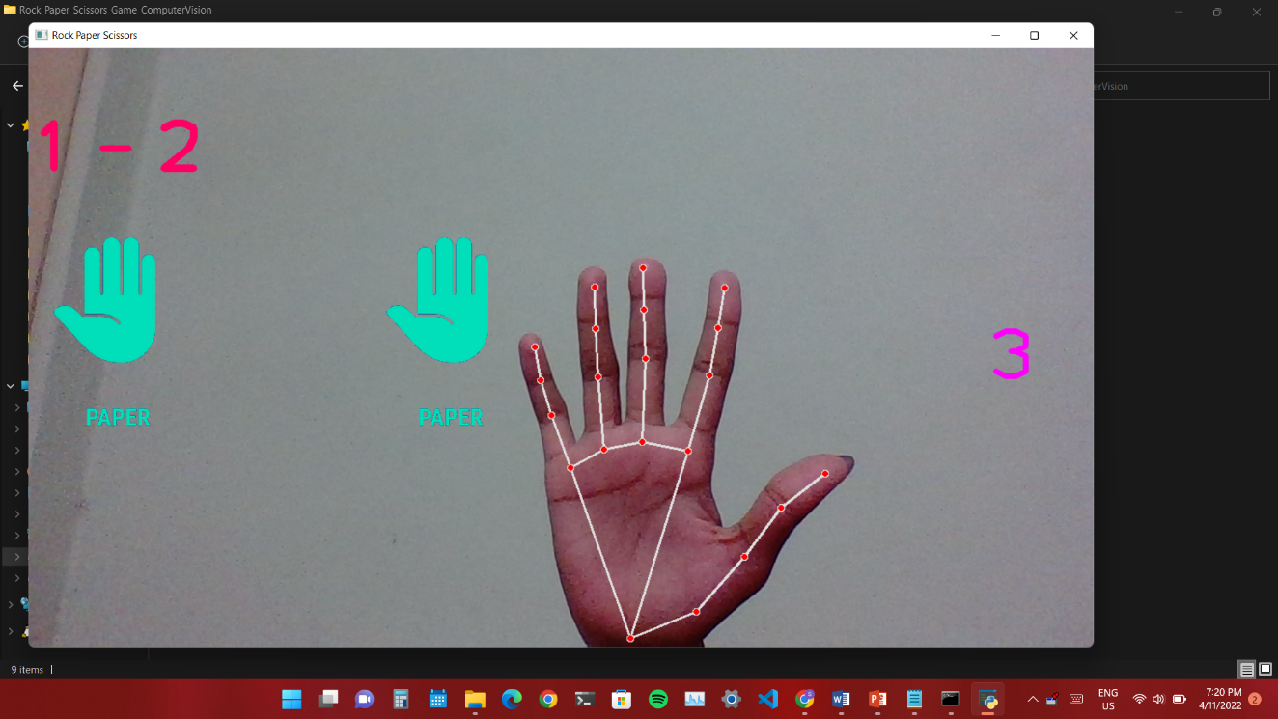
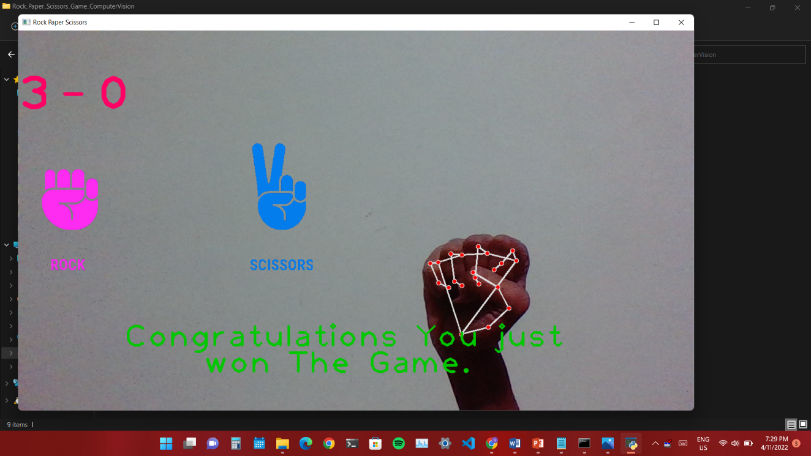
Results
Fg. Game UI while Playing
Fg. Game UI after Declaring Winner

Slide 31
Conclusion
An OpenCV and MediaPipe based RPS (Rock-Paper-Scissors) is proposed in this paper. The palm detection model and hand landmark model were used to identify the hand and its landmarks.
OpenCV has in-built image processing algorithms which preprocesses the frames captured and displays output as required by the user. Therefore, the application provides interactive environment between human player and AI (computer).

Slide 32
Future Work
This application can be converted into a mobile application.
This can be enhanced by linking this software with the Robotic Hand to play against the user.
This will be helpful in training the Robots to make relevant Hand Gestures.
In this we can include Machine Learning models to predict the user and generate hand gestures according to that, other than making random gestures.

Slide 33
References
[1] Heike Brock 1, (Member, IEEE), Javier Ponce Chulani2, Luis Merino 2, (Member, IEEE), Deborah Szapiro3, (Member, IEEE), And Randy Gomez 1, (Member, IEEE),” Developing a Lightweight Rock-Paper-Scissors Framework for Human-Robot Collaborative Gaming” Oct. 2020.
[2] H. Brock, S. Sabanovic, K. Nakamura, and R. Gomez, ‘‘Robust real-time hand gestural recognition for non-verbal communication with tabletop robot haru,’’ in Proc. 29th IEEE Int. Conf. Robot Human Interact. Commun. (RO-MAN), Aug. 2020, pp. 891–898.
[3] R. Gomez, K. Nakamura, D. Szapiro, and L. Merino, ‘‘A holistic approach in designing tabletop robot’s expressivity,’’ in Proc. IEEE Int. Conf. Robot. Automat. (ICRA), May/Aug. 2020, pp. 1970–1976.
[4] C. Lugaresi, J. Tang, H. Nash, C. McClanahan, E. Uboweja, M. Hays, F. Zhang, C.-L. Chang, M. Guang Yong, J. Lee, W.-T. Chang, W. Hua, M. Georg, and M. Grundmann, ‘‘MediaPipe: A framework for building perception pipelines,’’ 2019, arXiv:1906.08172. [Online]. Available: http://arxiv.org/abs/1906.08172

Slide 34


